Slide 1
Wind Integration in ERCOT
Beth Garza
Director, ERCOT IMM
bgarza@potomaceconomics.com
512-225-7077
Austin Electricity Conference
April 12, 2018

Slide 2
Thoughts on ERCOT’s Wind Generation Experience
More wind, more wind, more wind
Better reliability metrics
Reduced Ancillary Services Requirements

Slide 3
ERCOT Annual Energy by Fuel Type

Slide 4
2017 Unit Specific Wind Generation Capacity Factor

Slide 5
Wind Output and Estimated Curtailment

Slide 6
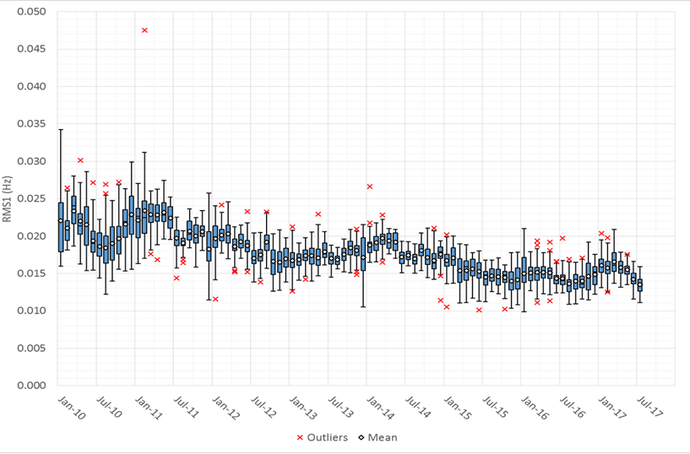
Improved Reliability Metrics

Slide 7
Declining Requirements for Ancillary Services

