Slide 1
The Economics of Transactive Energy Distribution Platforms
Lynne Kiesling, Purdue University
Austin Electricity Conference
April 2018

Slide 2
Digital technologies are transaction cost reducers
Source: Campus Technology,
https://campustechnology.com/articles/2015/11/10/top-mobile-trends-to-watch-in-2016.aspx
Notes:
The growth of business models based on digital platform sharing -- with Uber and Airbnb standing out as obvious examples -- has attracted both popular and scholarly attention. But there has been little price-theoretic analysis of the underlying economic forces driving these dramatic changes.

Slide 3
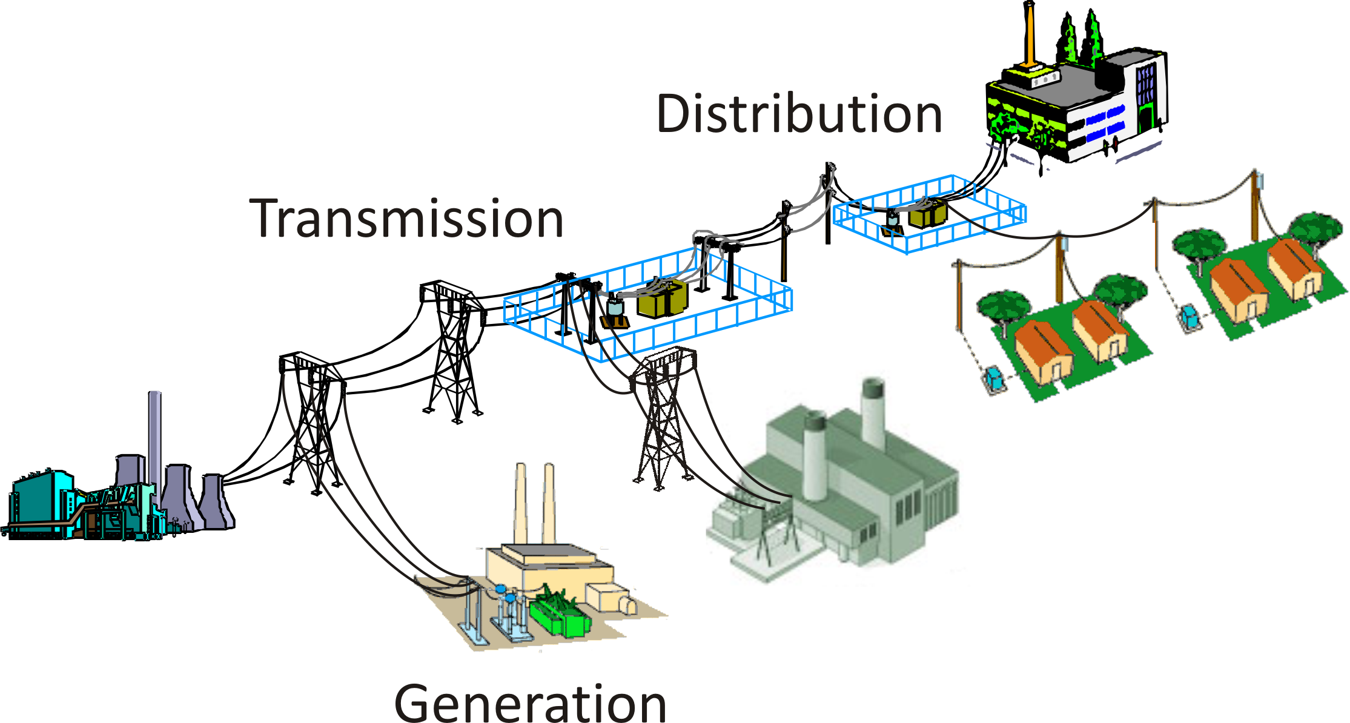
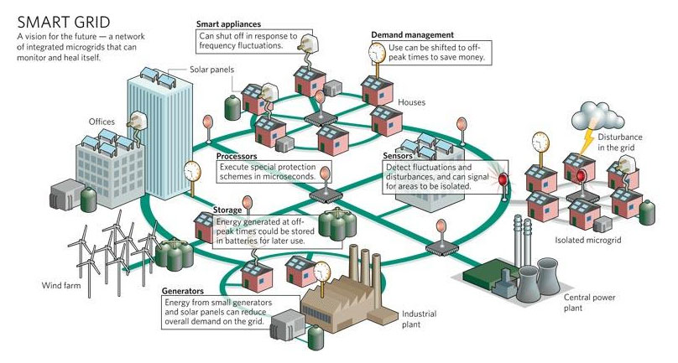
Digital innovation at the edge of the network
Notes:
This slide and the next one illustrate the importance of paying attention to incumbent vertical market power, because retail entry deterrence’s most costly long-run consequence could be by perpetuating barriers to innovation. Invoke permissionless innovation at the edge of the network, with the Internet and its creative vibrancy as an example that has been transformative.

Slide 4
Defining transactive energy
“Techniques for managing the generation, consumption or flow of electric power within an electric power system through the use of economic or market-based constructs while considering grid reliability constraints” (GWAC)
Decentralized, bottom-up decision-making
Using the exchange of value via transactions to enable coordination of
Production/generation of electricity
Consumption/use of electricity
Use of network capacity (use rights to a common-pool resource)
Encompasses two dimensions of coordination
Institutions: market design, rules governing exchange
Technology: degree of autonomous control

Slide 5
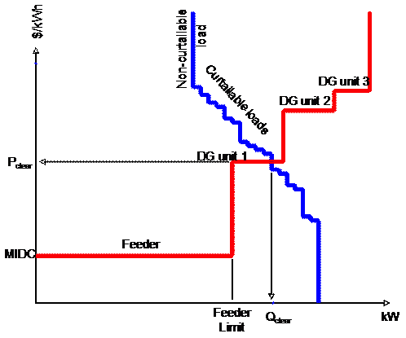

Slide 6
Transactive distribution platforms
Source: IRENA

Slide 7
Overcoming challenges (an incomplete list)
Financial & regulatory
Determining who pays for upgrades and how
Complicated rate transition questions
Retail competition or just retail choice?
Stranded costs 2.0?
Functions of grid services company/DSO
BUT some experiments already
Cultural
Transition from least-cost to value-creating mindsets
Engineering & economic transition from centralized control to decentralized coordination
Utility transition from vertical integration to markets
Regulatory transition from rate setting to competition policy
Customer transition from “plain vanilla” to engaged & aware, yet automated
These challenges are the most difficult – incentives & tradeoffs
Technical (technology & market)
Integrating sensing, monitoring, interconnection capabilities
Two-way flow
Decentralized frequency & voltage regulation
Distribution-level price determination reflecting spatial costs and benefits
BUT these are not physically or economically impossible
TE
platforms

Slide 8
Top takeaways & regulatory implications
Digital technologies are massive transaction cost reducers, and a transactive energy approach can direct those cost reductions to consumers.
Openness to interconnection and markets around the distribution edge can enable the experimentation that leads to innovation. Don’t perpetuate costs and entry barriers that stifle them.
Business model implication: A distribution platform business model enables the wires utility to evolve into providing grid services to decentralized parties around the distribution edge.
Transactive digital platforms turn transaction cost reductions into consumer and producer surplus.

