Slide 1
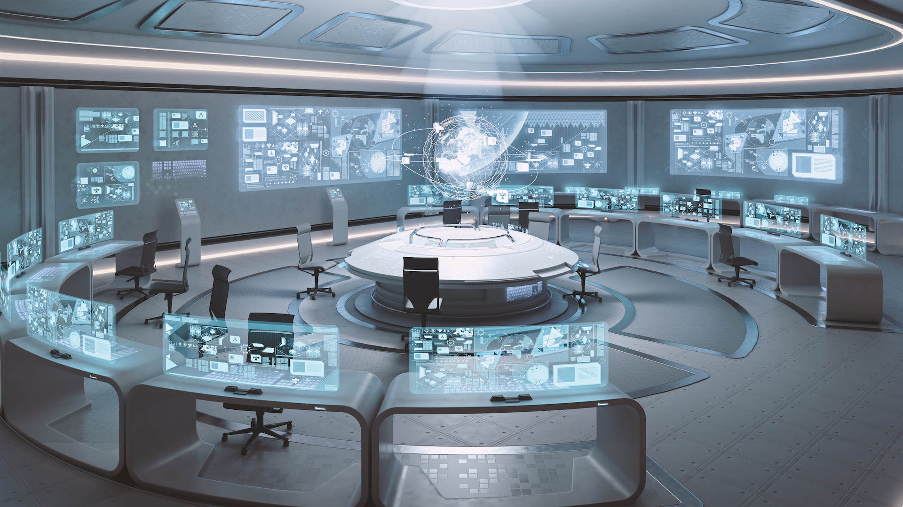

Engineering Cyber Resiliency
Mike Legatt, Ph.D., CPT
Austin Electricity Conference
April 13, 2018
Notes:
Attention!
Before you open this template be sure what you have the following fonts installed:
Bebas Neue
http://www.fontsquirrel.com/fonts/bebas-NEUE
Aller
http://www.fontsquirrel.com/fonts/Aller
Icon Sets Font:
http://www.webhostinghub.com/glyphs/
All fonts are permitted free use in commercial projects.

Slide 2
Core Philosophy:
“All organizations are perfectly aligned to get the results they get.”
Arthur W. Jones
Photo: J. Merlo, NERC
Notes:
It is best to align our people to react positively, not fearfully.

Slide 3
Defining Resiliency in a Cyber Context
  Resiliency – “The intrinsic ability of a system to adjust its functioning prior to, during, or following changes and disturbances, so that it can sustain required operations under both expected and unexpected outcomes”
  Resiliency Engineering - primary source of resiliency from human, not technological components:
    Real-time SOC/NOC operators
    Developers within their organizations
    Collaboration between organizations during planning and emergency situations
Hollnagel, E., Paries, J., Woods, D.D., Wreatha, J. (Eds.).(2013).
Resilience engineering in practice: a guidebook. Ashgate Publishing, Ltd.

Slide 4
Defining Resiliency in a Cyber Context
  Therefore, to strengthen an organization’s resiliency, you need:
    Measuring maturity and current state
      E.g., C2M2/cyber, WHPM / human performance
    Building the optimal environment for human resiliency
      High Reliability Organizational Culture
      Just Culture
      “Team of Teams” approaches
    Human-factors design and system design to optimize human performance
    Building habits of resiliency
      Different neocortical areas, level of effort, and speed for engaging in a strong habit than thinking through a process.
    Recognition of the challenges to resiliency from human side
      E.g., fatigue, information overload, “out of the loop”, loss of situational awareness
Hollnagel, E., Paries, J., Woods, D.D., Wreatha, J. (Eds.).(2013).
Resilience engineering in practice: a guidebook. Ashgate Publishing, Ltd.

Slide 5
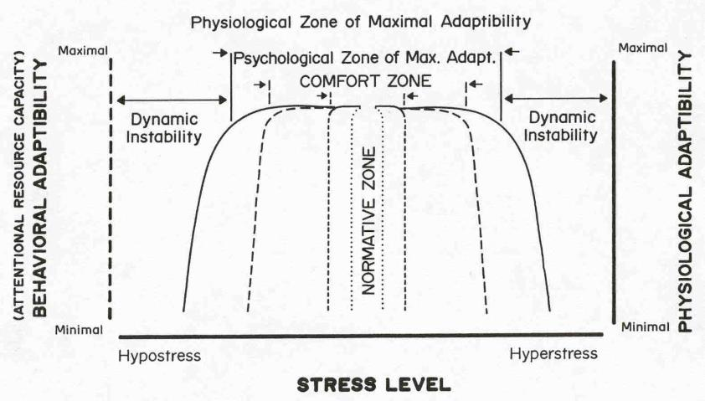
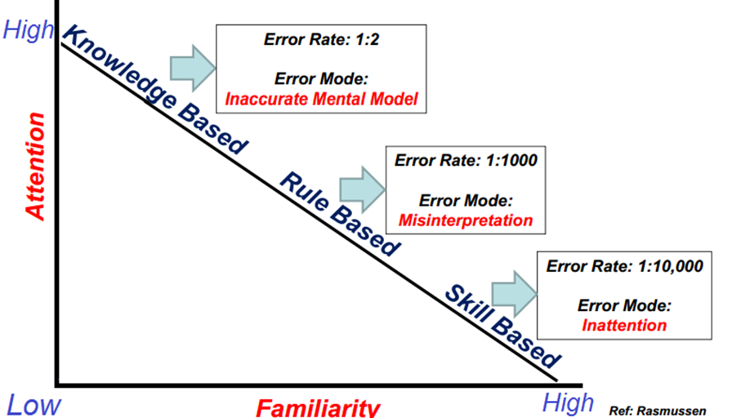
Manage Cognitive Load
Workflow analysis, specific and holistic
Analysis of short-term memory loading (7 ± 2 chunks; Miller, 1956)
Recognition that humans make 3-7 mistakes per hour, 11-15 under stress (Muschara, 2014)
Recognition of lower cognitive resource availability in emergencies
Analysis against predictable failure modalities in emergencies
A Dynamic Model of Stress and Attention, from Hancock & Warm (1989)

Slide 6
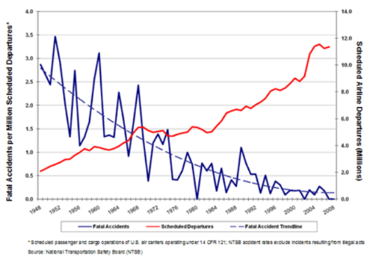
Design for Situational Awareness
  Building strong mental models, complex pattern recognition and situational awareness requires time, space, and adaptive capacity/slack, as well as the right environment and training
Performance
Mental
Models
Stress/
Perceived
Safety
Working
Memory
Situational
Awareness
Pattern
Recognition
Attention
Workload
Motivation
Based On: Kass, S. Military Psychology

Slide 7
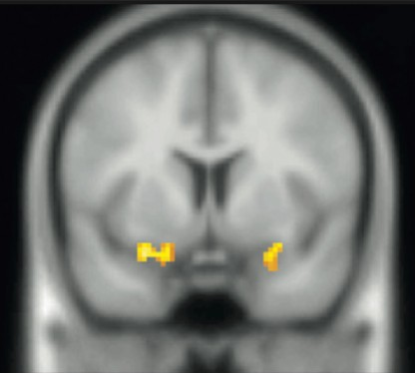
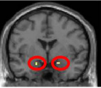
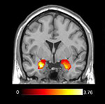
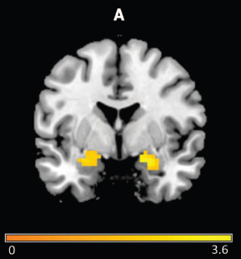
Continuously Improve Organizational Culture
Capture and act upon “small signals”, such as near misses
Recognize that success in an emergency requires adaptive capacity
Ensure Deference to Expertise
Avoid Outcome Bias and other cognitive biases
Ensure fast-moving automation incorporates operators “In the loop” and recognizes human information processing capabilities

Slide 8
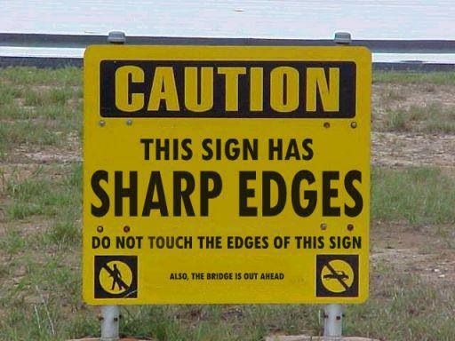
Focus on What’s Important

Slide 9
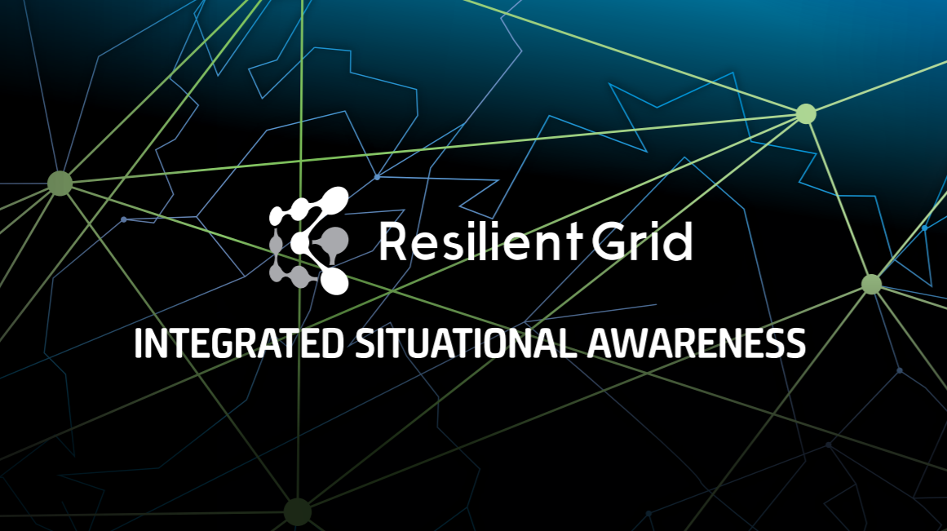
Thank you
Mike Legatt, Ph.D., CPT
legatt@resilientgrid.com

Slide 10


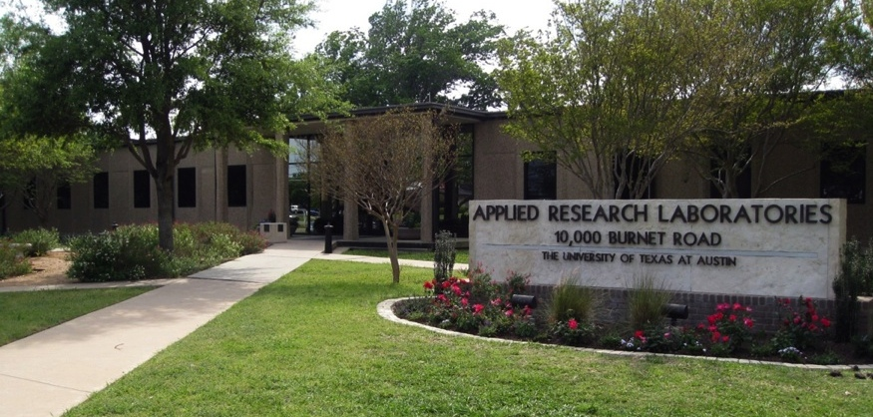
Cyber-Security Thoughts for
Austin Energy Conference
(A funny thing happened on the way to utopia)
April 13, 2017
Alex Athey, PhD
Emerging Security and Technology Group
Applied Research Laboratories
The University of Texas at Austin
alex.athey@arlut.utexas.edu 512-835-3589

Slide 11
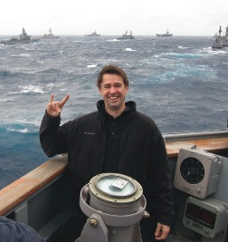
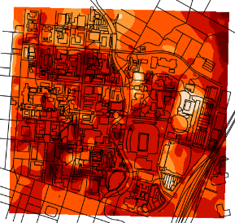
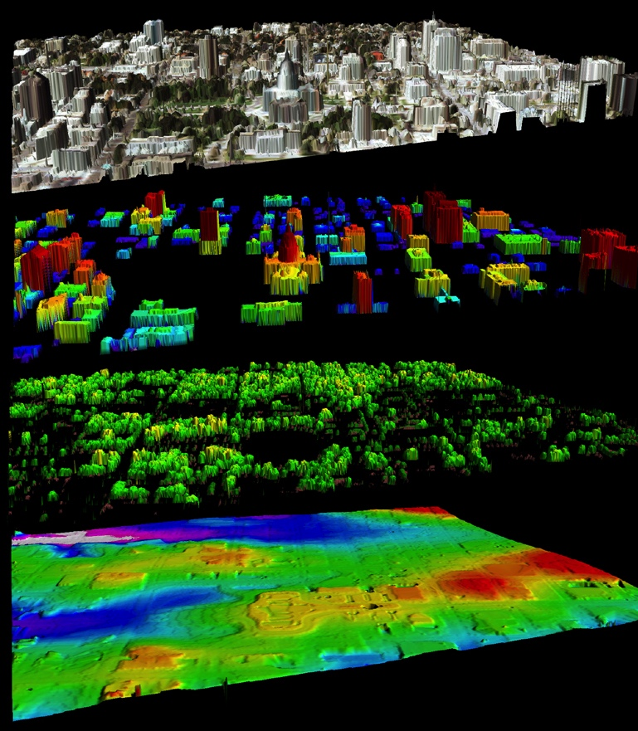
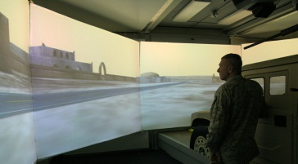
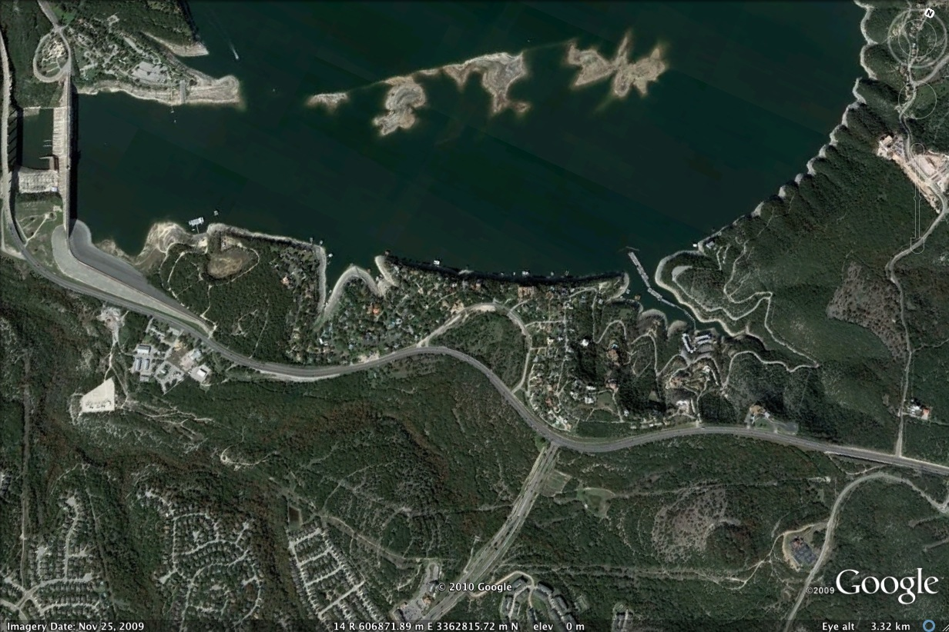
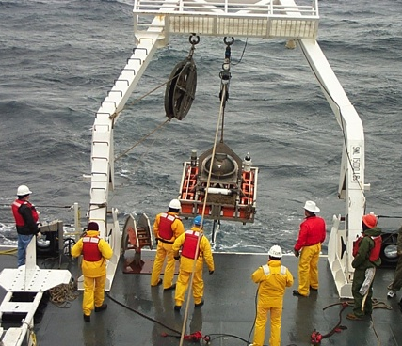
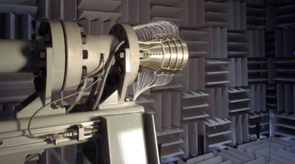
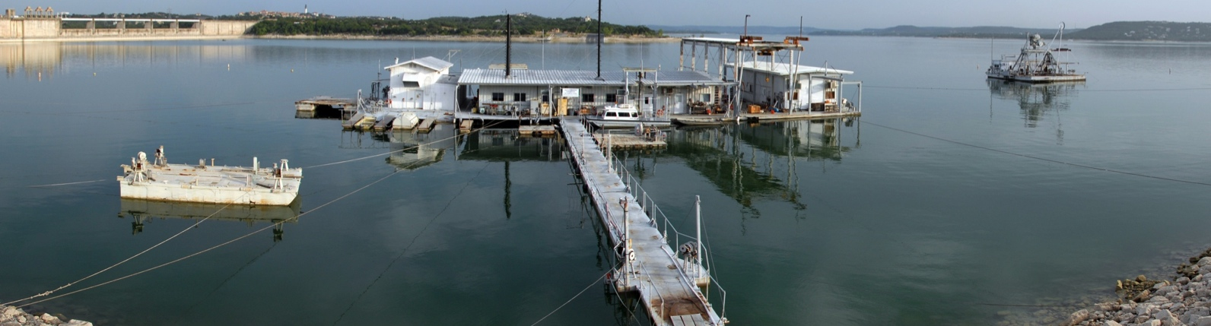
Applied Research Laboratories
Founded after WW II in trusted relationship with Government
Expanded in size and scope over last 70 years
  GPS
  IT Research
  EM Propagation
  Remote Sensing: EM, Optical, High Energy
  Autonomous System / ROVs
  Acoustics: Military → Industrial/Medical
Technical Program Areas: Acoustics, Electromagnetics, Information Technology, System Engineering
700 Staff
  400 Research Staff Staff (20% PhD, 30% MS/MA, 50% BS/BA)
75-150 Students
4 Labs (ATL, ESL, SGL, SISL)
$120M Research Funding Level per Year (all soft money)
ARL has a core mission to operate as bridge between basic research in academia and prototyping and applied engineering solutions for government and industry.
LAKE TRAVIS TEST STATION
500 M
2500 M

Slide 12
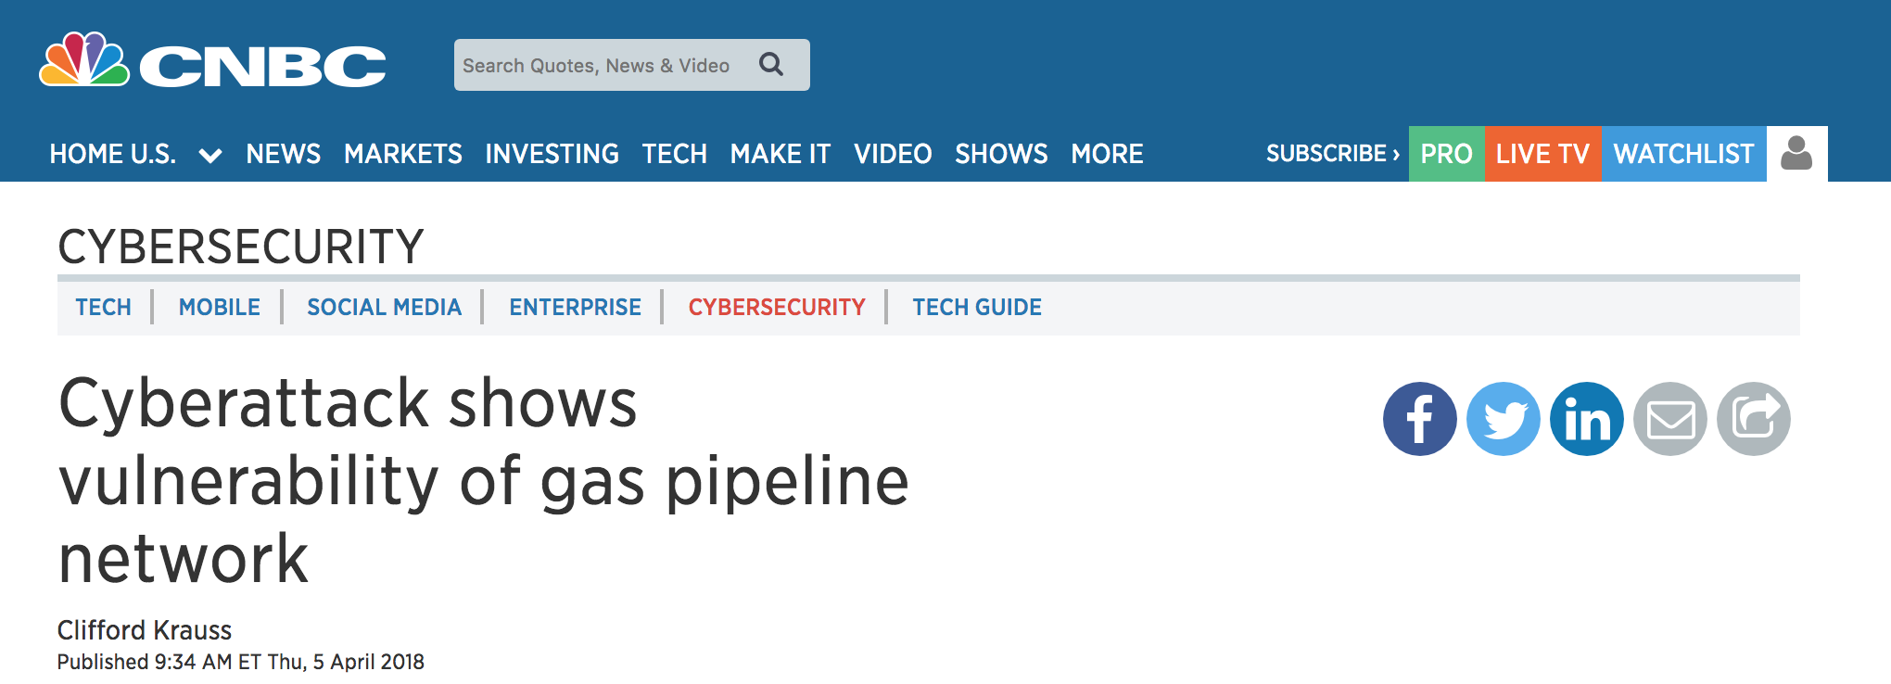

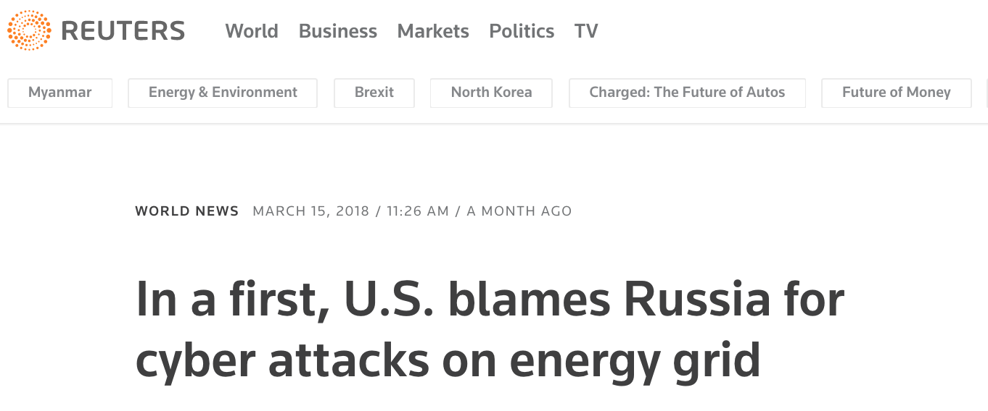

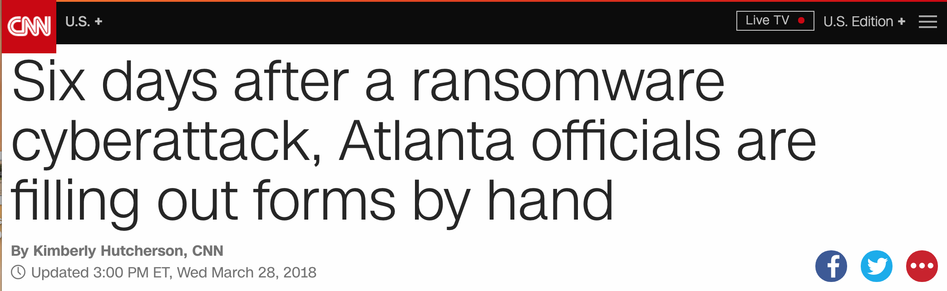
Cyber-Security;
How Did We Get Here?
“Internet, you used to be so cool”
circa 2013
Within past month; Mar – Apr 2018

Slide 13
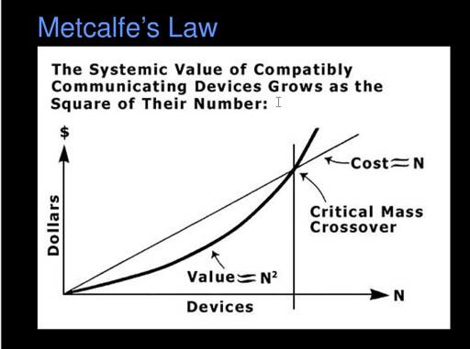
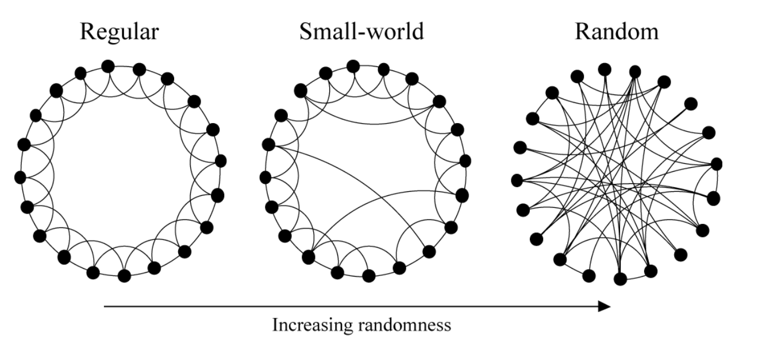
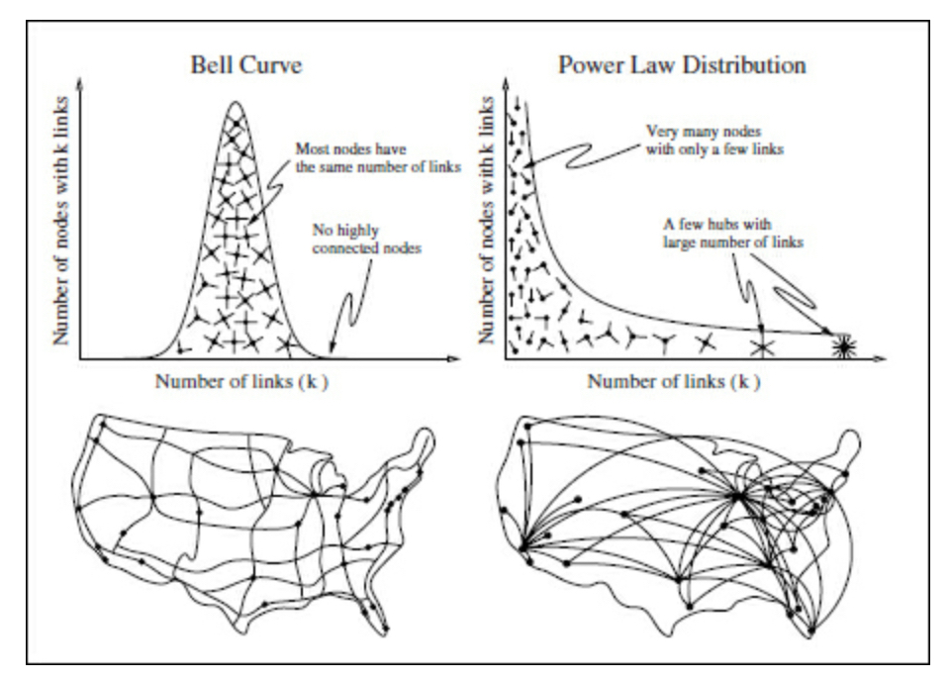
“Laws” of Networks
Watts and Strogatz’s Small World Network
The more things that are connected, the more valuable the network; Strong motivation to connect everything from electric utilities to internet devices to individuals through social media.
Small World Networks are frequently observed in real world
6-degrees of separation (from Kevin Bacon)
Network growth and self-organization occur with
preferential attachment, results in hubs and power-law distributions
Hubs are uniquely valuable in network.

Slide 14
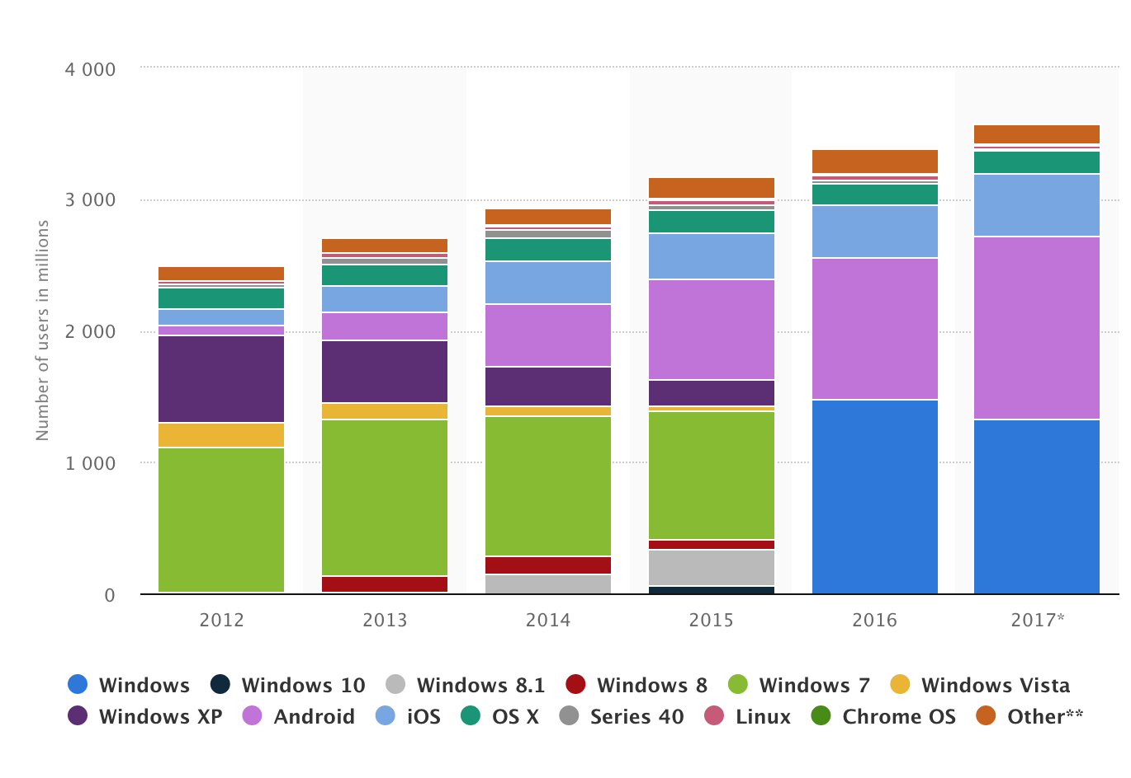
Building The Glass House
MLOC
OSX | 85
Windows | 60
Linux | 20
MS Office | 25
Firefox | 15
MySQL | 12
Facebook | 60
Defects Vulnerabilities
Estimate of OSes for Computer, Smart Phone, Tablets
Total Devices estimates 18B (6-9B in IOT)
Exceptional - Good Code has defect rate of 1-6 per 1000 LOC
1-5% of defects are vulnerabilities
--------------------
For every 10’s MLOC codebase there are several hundred to several thousand vulnerabilities
Gartner, International Data Corp, IHS Markit, StatCounter, ITU
Information is Beautiful
McConnell, CERT SEI

Slide 15
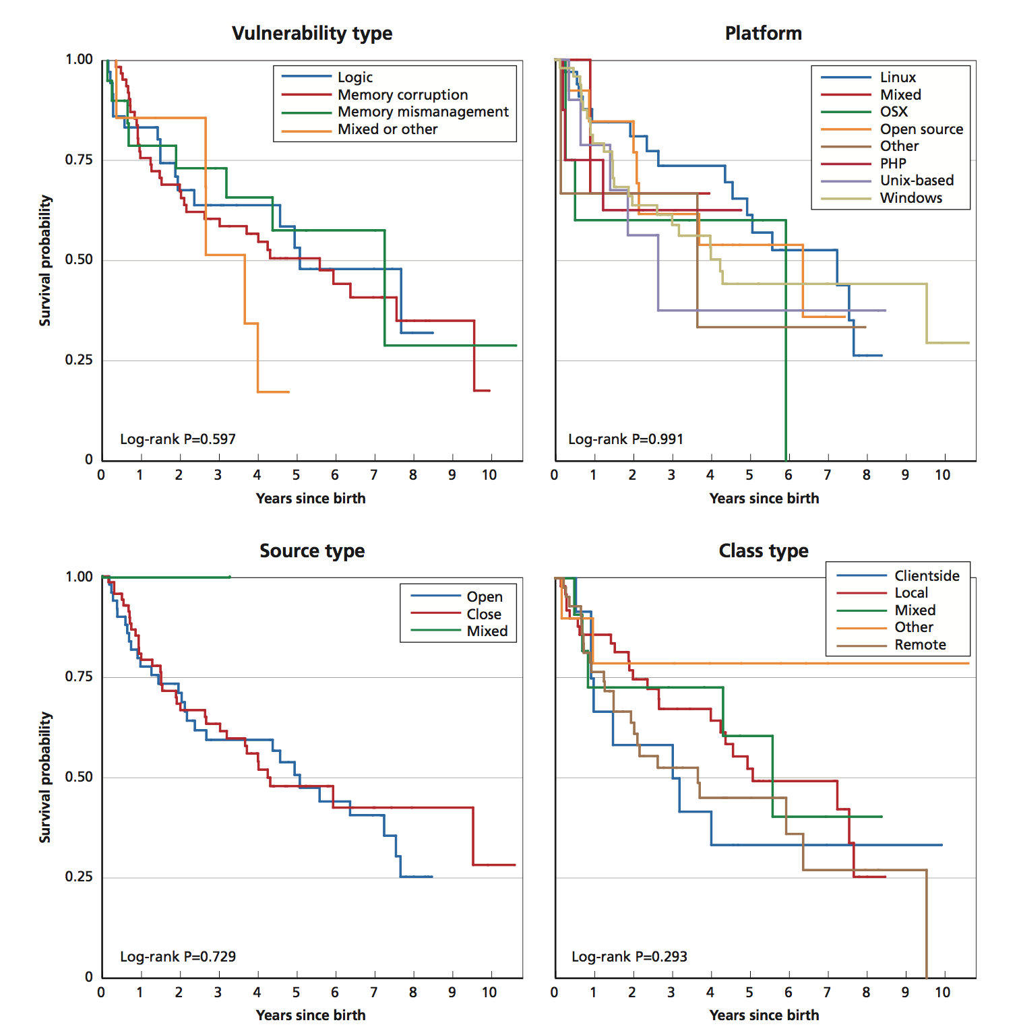

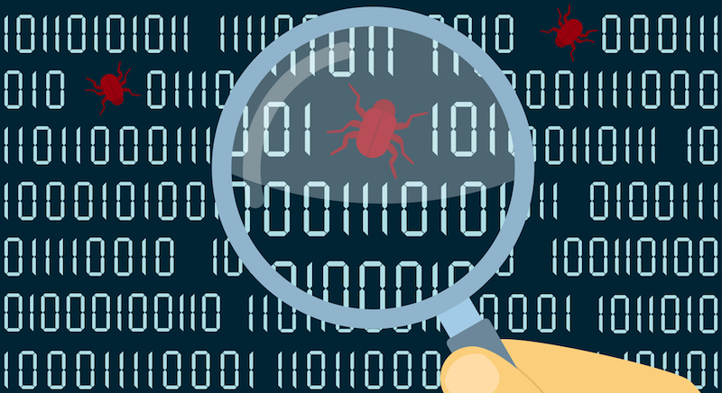
Fix the Codebase?
Zero-Day, Thousands of Nights
Rand Study
“Obtained” a zero-day database
Over 200 vulnerabilities
Maintained over 14 year period (2002-16)
Avg life expectancy 7 years
10% of vulnerabilities are immortal

Slide 16

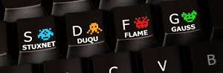






Rise of the Nation-State Cyber Actor
(Invention of Stones for Previously Built Glass Houses)
Stuxnet |  |  | <-numerous->
 |  | Google Yahoo |  |  | Belgacom
Stuxnet |  |  |  |  | National Iranian Oil via Wiper |  | Kaspersky
Capabilities Waterfall
 |  | Google RSA | PLA 61398 APT1 |  |  |  | OPM
Nation-State
TCO
Estonia |  |  |  |  |  |  | US State Dept | French Media Ukraine Grid | Brexit | DNC
Transnational Terrorism
 |  |  |  |  |  | Banks & Media in S.Korea | Sony | SWIFT Banking |  | WannaCry
Groups / Hackers
 |  |  |  | US banks | Saudi Aramco via Shamoon | US Dam |  | Turkey Grid |  | UK Parliament
Lines are blurring and Nation attacks pulling up lower tiers.
2007 | 2008 | 2009 | 2010 | 2011 | 2012 | 2013 | 2014 | 2015 | 2016 | 2017 | 2018
Wired, Wikipedia, NYTimes, Other Open Sources

Slide 17
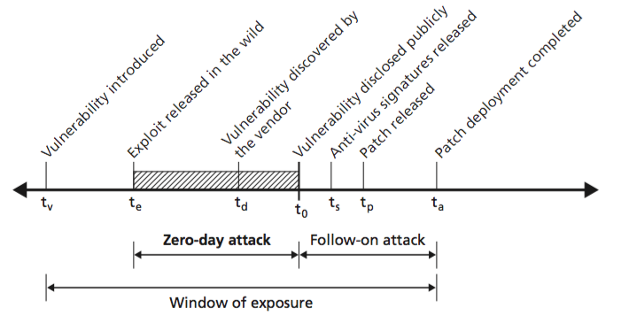
Attacks: Sophistication, Length, Frequency
Sophistication
BlackEnergy install was mini-OS
Filesearch
Remote desktop
Port Scan
USB Collection
BIOS Info
Screen shots
Password theft
Password hash
Logging
Backup channel
Proxy Server
Updater
Length
Frequency
1 in 600 emails is malware
(Symantec)
1 in 3000 emails is phishing
(Symantec)
58 records are stolen per second
(Gemalto)
39 seconds between attacks
(U Maryland Study)
1 in 3 American hacked in past year
(Zogby Analytics)
StuxNext (active 2005, discovered 2010)
NetTraveler (active 2004, discovered 2013)
Icefog (active 2010, discovered 2013)
Energetic Bear (active 2010, discovered 2014)
Fancy Bear (probing 2015, discovered 2016)

Slide 18

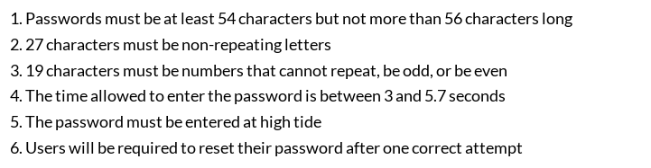
Current Practices
Cyber-Physical Defense Today
  Hundreds of “Top Ten” list of security practices / standards / best practices / roadmaps / case studies
  Federal : NIST, ICS-CERT, PPD-21, DHS, DOE, NSA, National Labs,
  Industry: ISO, IEEE, SANS, Rand, Microsoft, McAfee, Kaspersky, Tofino, Juniper
  Defense Pubs: DoD 8510.01, 8500.01, CJCSM 6510.01B, CNSSI 1253, Cybersecurity Discipline Implementation Plan, DSB studies, Unified Facilities Criteria 4-010-06
Security as Checklist (SAC)
    Cybersecurity is $70B/yr industry growing at least 15%/yr and yet surveyed professionals feel the adversary is gaining on defenders and systems are not adequately protected. Not for lack of “guidance” (see above).

Slide 19
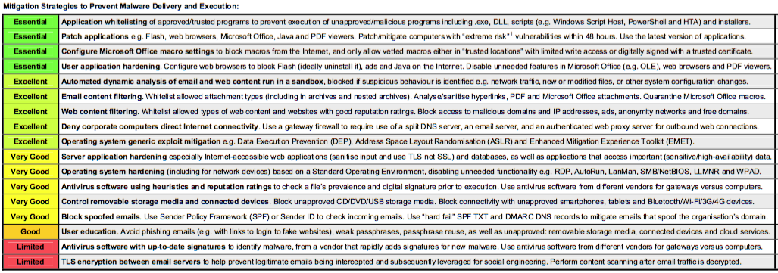
Practical Solutions for Today
Australian Signal Directorate (& DHS ICS-CERT)
  Examining the constant attacks to prioritize mitigations for effectiveness
Best in class discussions: Defense Science Board; Cyber Defense Management (2016)

Slide 20
Philosophical Solutions for Tomorrow
Thriving entities in information era are decentralized; How to evolve / leverage for 20th century centralized entities, such as Utilities
  Microgrids (at what scale? Individual, Block, Community, City)
  Isolation Strategies (Texas?) vs Interconnects
  De-risking “hub” structure of small world networks
Fully understand modern vulnerabilities (DG, DR, EV).
  Can one disgruntled employee at NEST overload grid by overriding all DR at peak power draw on summer day?
Digitization, connection, system speed, functionally is a choice
  Does everything need to be plugged in?
    Just for Sensing?
    Including Control?
Resiliency is rooted in dynamic ability to communicate and adapt
  Human are extremely good at this! Make sure empowered when need arises.

